Slide 1
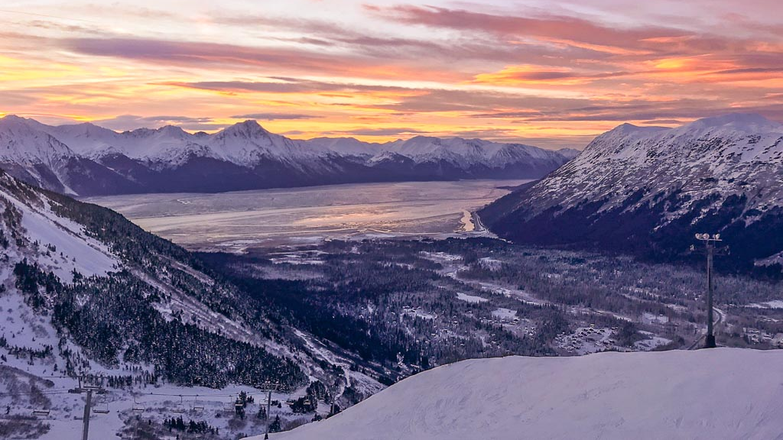
Holtan Hills
In Girdwood, Alaska

Slide 2
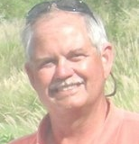
History of Holtan hills
Holtan Hills is named after lifelong Alaskan Howard Holtan. Howard was the Director of Project Management and Engineering for the Municipality of Anchorage.
Howard was also the Program Director of the Alyeska Mighty Mites program from the mid 1980’s until his untimely death in a plane accident in 2007. Howard took great joy in seeing the kids ski the entire mountain with a laugh and a smile.
Out of gratitude and deep respect for Howard, the Heritage Land Bank named Holtan Hills after Howard so his legacy in Girdwood may live on.

Slide 3
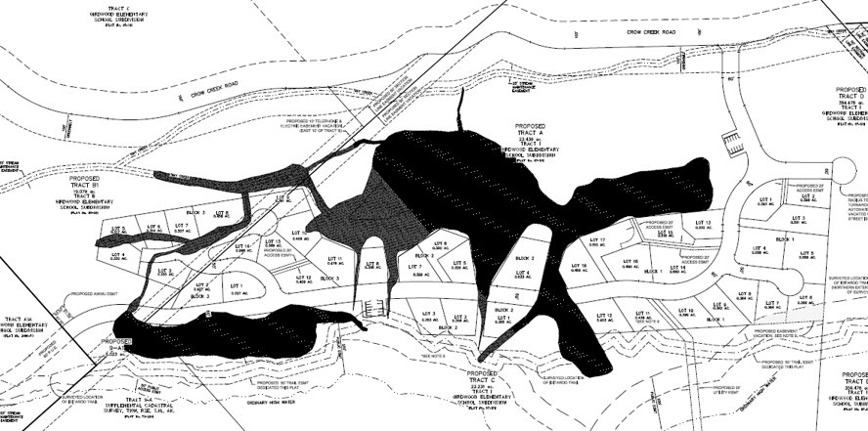
History of Holtan Hills

Slide 4
Meeting info
This meeting serves as our community meeting as required by the Municipality of Anchorage.
LIVE CHAT
During this presentation, the chat room will be active.

Slide 5
Heritage Land Bank Request for Proposal (RFP)
In April 2021, the Heritage Land Bank put out an RFP to develop a portion of their Girdwood holdings. In June 2021, the RFP was reviewed by the Selection Committee who was comprised of:
Christopher M. Schutte, Office of Economic & Community Development Director
Robin E Ward, Real Estate Department Director
Tiffany Briggs, Program & Policy Department/Manager, Real Estate Services
Steve Schmitt, Municipal Surveyor, PM&E
Kristi Bischofberger, MOS Watershed Manager
Mark Schimscheimer, Director of Engineering, AWWU
Kyle Kelly, Girdwood Valley Service Area Manager
Diane Powers, Admission Manager, Alaska Wildlife Conservation Center
Andrew Romerdahl, Senior Director of Real Estate, Cook Inlet Region, Inc.

Slide 6
Heritage Land Bank Request for Proposal (RFP)
On June 29, 2021, with a unanimous vote by the Selection Committee, the RFP was awarded to the CY Investments, LLC team which included
A proposed partnership between the Municipality of Anchorage, Heritage Land Bank and the CY Investments, LLC development team.
MOA
HLB
Development Team
Girdwood
Community

Slide 7
Heritage Land Bank Request for Proposal (RFP)
At the heart of the proposal was the creation of a mixed density community with homesites of varying shapes and sizes to be sold to local and regional builders and private parties as individual homesites and multi-family tracts.
Due to the shortage of local occupied housing in Girdwood, the developers will offer the Holtan Hills homesites to Girdwood residents only for the first two weeks of homesite availability.

Slide 8
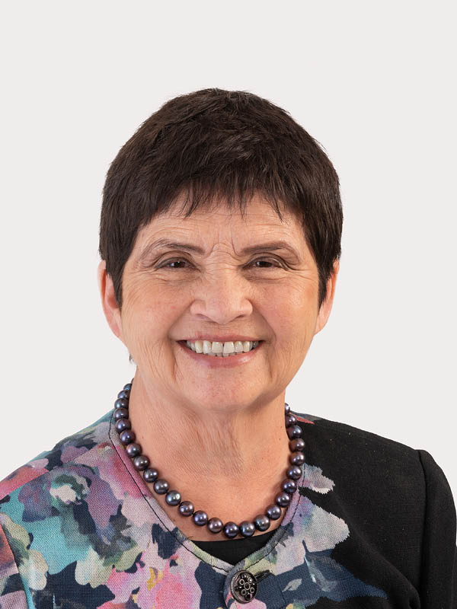
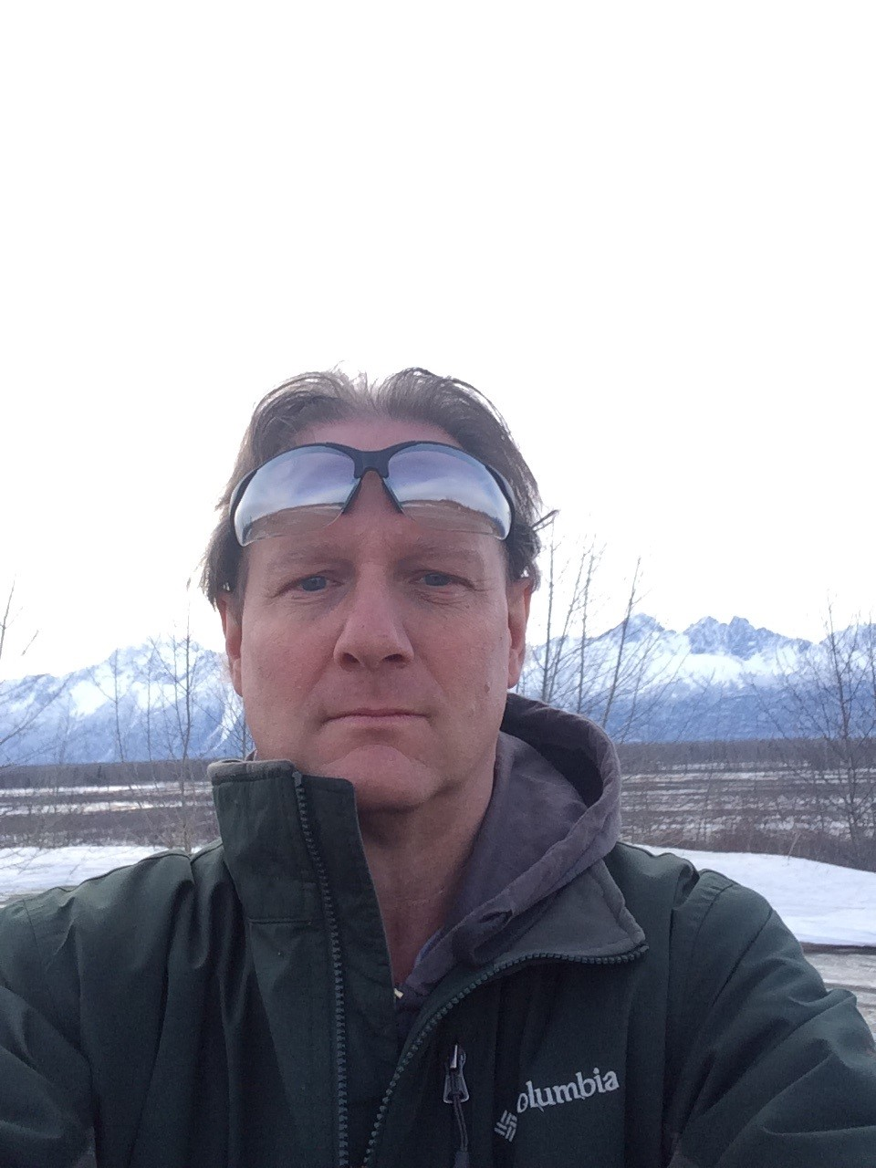
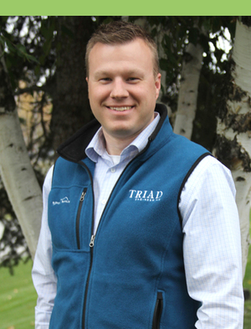
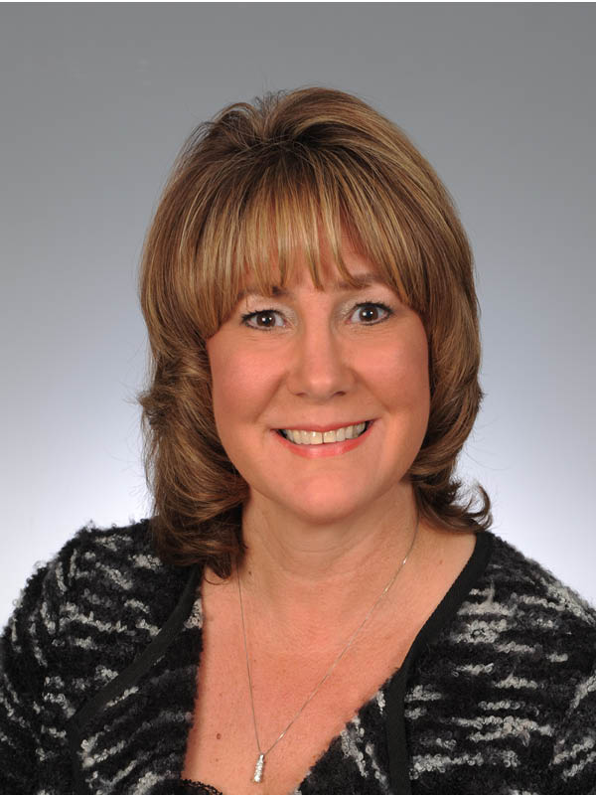
Holtan hills development team
Connie Yoshimura
CY Investments
Owner
Berkshire Hathaway HomeServices Alaska Realty
Broker/Owner
Shelley Rowton
Land Management Officer
Heritage Land Bank
Tony Hoffman, P.L.S
Senior Surveyor
The Boutet Company
Natalie Travers-Smyre
Associate Broker
Manager, HOA Management Division
Berkshire Hathaway HomeServices Alaska Realty
Charlotte Gaston
Realtor
Admin Assistant
Berkshire Hathaway HomeServices Alaska Realty
Brandon Marcott, P.E
Principal Engineer/Owner
Triad Engineering
Seth Andersen, P.E
Owner, Arete, LLC

Slide 9
Community support
We need the support of the Girdwood Community to make this project successful.
We are here to listen to your
ideas and concerns.
Holtan Hills cannot become a reality without your support and approval.

Slide 10
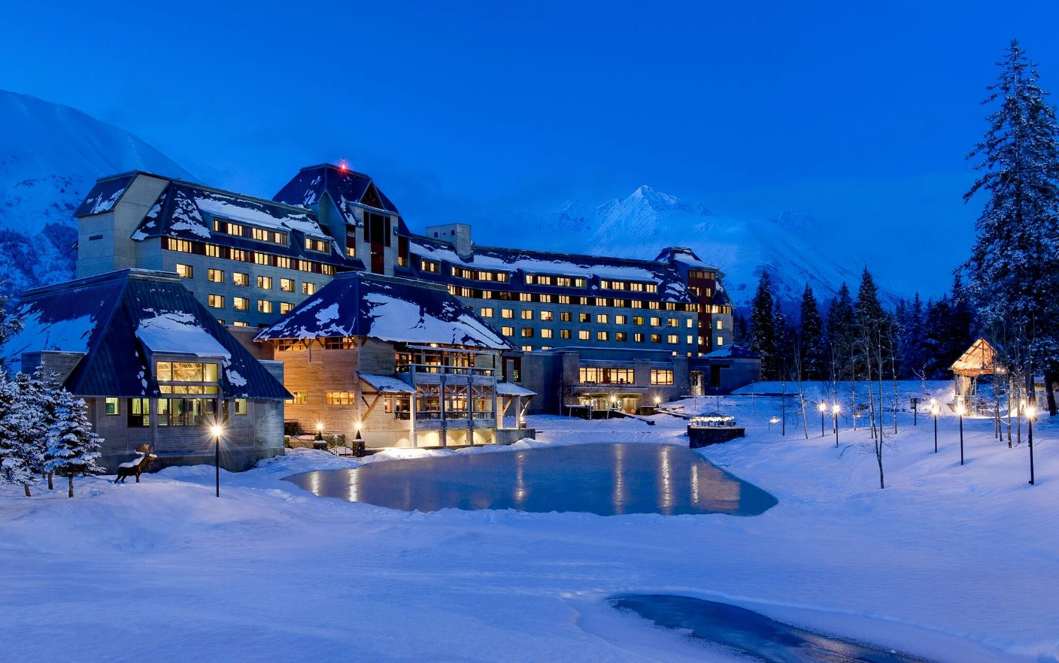
The steps that need to be completed before we can break ground.

Slide 11
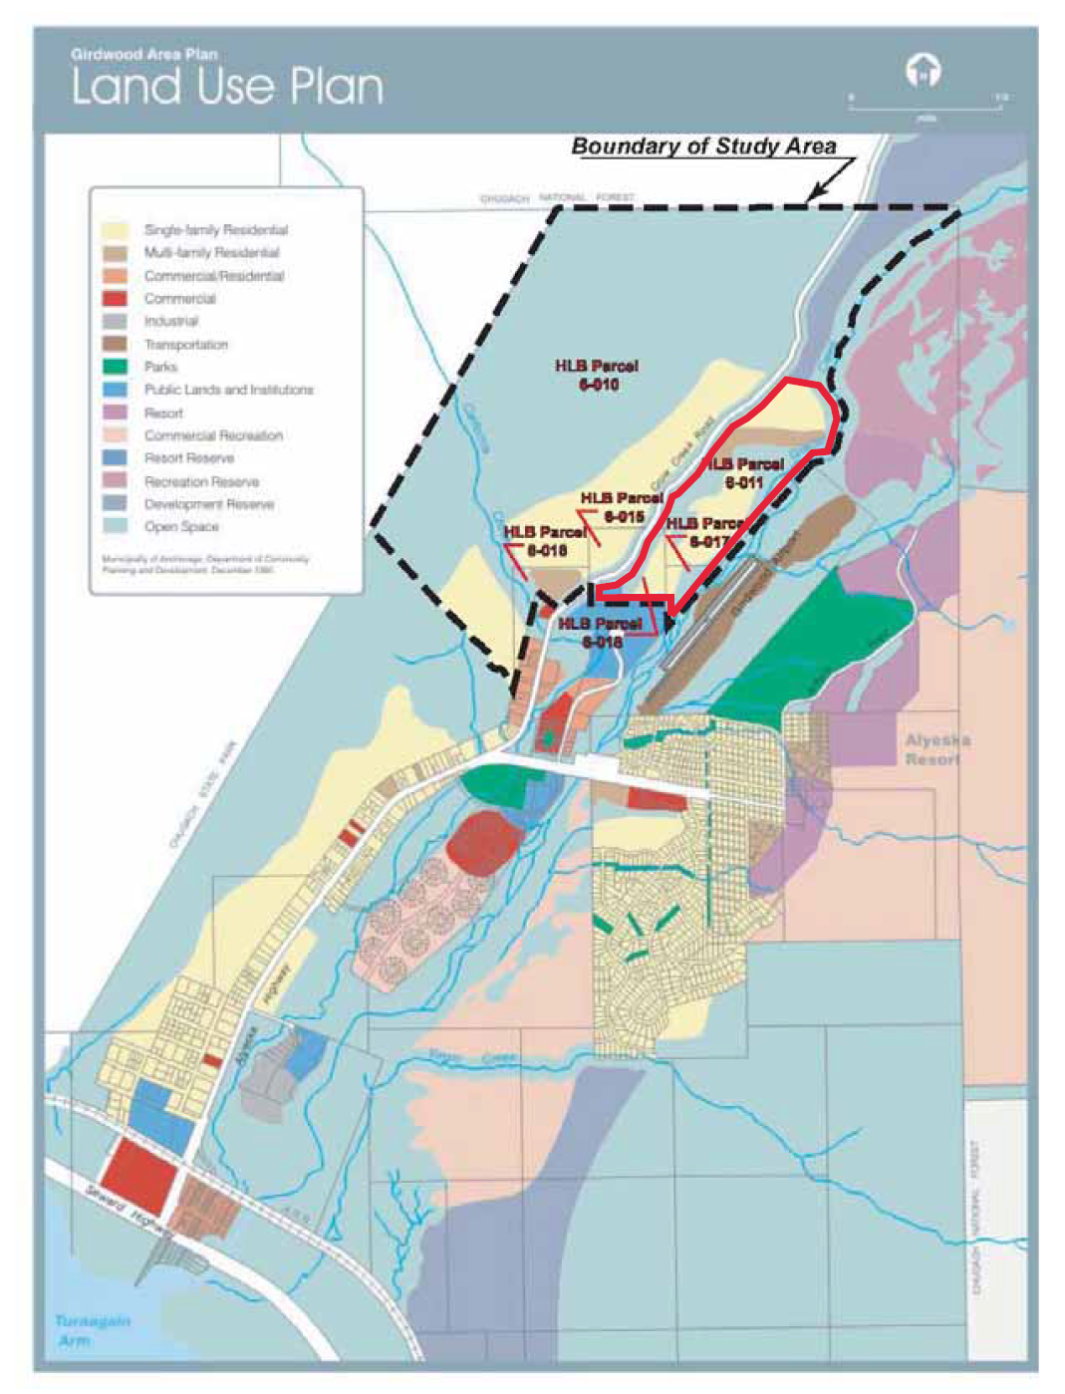
Overall process
Area Master Plan → Conditional Use Permit for Residential Planned Unit Development → Phased Subdivision Plat

Slide 12
Three Applications → one public hearing
Planning & Zoning Commission – AMC 21.02.030
The Planning and Zoning Commission has decision-making authority over the following:
Conditional uses (AMC 21.03.080)
2. Preliminary plats, when a conditional use creates a subdivision or requires vacation of a dedicated public area, and the commission directs in the conditional use approval that it shall act as the platting authority (AMC 21.03.080F)
Review and Action by Planning and Zoning Commission – AMC 21.09.030h
The Planning and Zoning Commission shall hold a public hearing on the proposed area master plan.

Slide 13
Area master plan – AMC 21.29.030E
Purpose
An area master plan is intended to facilitate the planned development of large tracts of land under unified ownership or control, prior to subdivision or development of entire tracts or parcels within large tracts, in order to provide for land use compatibility and development responding to site-specific environmental constraints and opportunities. The area master plan shall establish the general arrangement of land uses, circulation and infrastructure systems for the identified development areas.
Applicability
An area master plan review is required prior to development in any of the following Girdwood zoning districts: gR-3, gC-5, GRST-2, GCR-1, GCR-2, GCR-3, GDR, GRR.

Slide 14
Conditional use permit for residential planned unit development – AMC 21.07.110H
Intent and Approval
A residential planned unit development (PUD) is intended to allow flexibility for residential development in the zoning ordinance and to achieve the creation of a more desirable environment than would be possible through a strict application of the zoning ordinance. A residential PUD shall be processed as a conditional use in accordance with section 21.03.080. The planning and zoning commission shall evaluate the proposed planned unit development in accordance with the conditional use approval criteria at section 21.03.080D., and the following additional criteria:
a. Creative use of the land, imaginative architectural design, a consolidation of usable
open space and recreation areas, and the preservation of natural features.
b. The mixing of compatible land uses, residential densities, and housing types within
the neighborhood.
c. The efficiency of the configuration of utilities, vehicular circulation, and parking
facilities.
d. Enhancing the surrounding environment.
e. Maintaining population densities and lot coverage that are consistent with available
public services and the comprehensive plan.

Slide 15
Phased subdivision – AMC 21.08
General
These standards are enacted generally to promote the goals of the comprehensive plan as to the health, safety, convenience, quality of life, and welfare of the present and future inhabitants of the municipality; to secure adequate utilities and public facilities, provide for consideration of school and open space needs, and protect sensitive natural areas such as critical habitat, high-value wetlands, and riparian corridors; to enhance or preserve other significant natural features; to ensure the functional and efficient layout and appropriate use of land so as to achieve property lots of reasonable utility and minimize public costs to construct and maintain infrastructure; and to facilitate orderly growth and harmonious development of the municipality.

Slide 16
Working Holtan hills site plans
Please note: The following are working plans and are subject to change due to wetland delineation, topography, rezone, section line easement vacation and other environmental factors such as drainage.

Slide 17
PHASE ONE

Slide 18
SITE PLAN

Slide 19
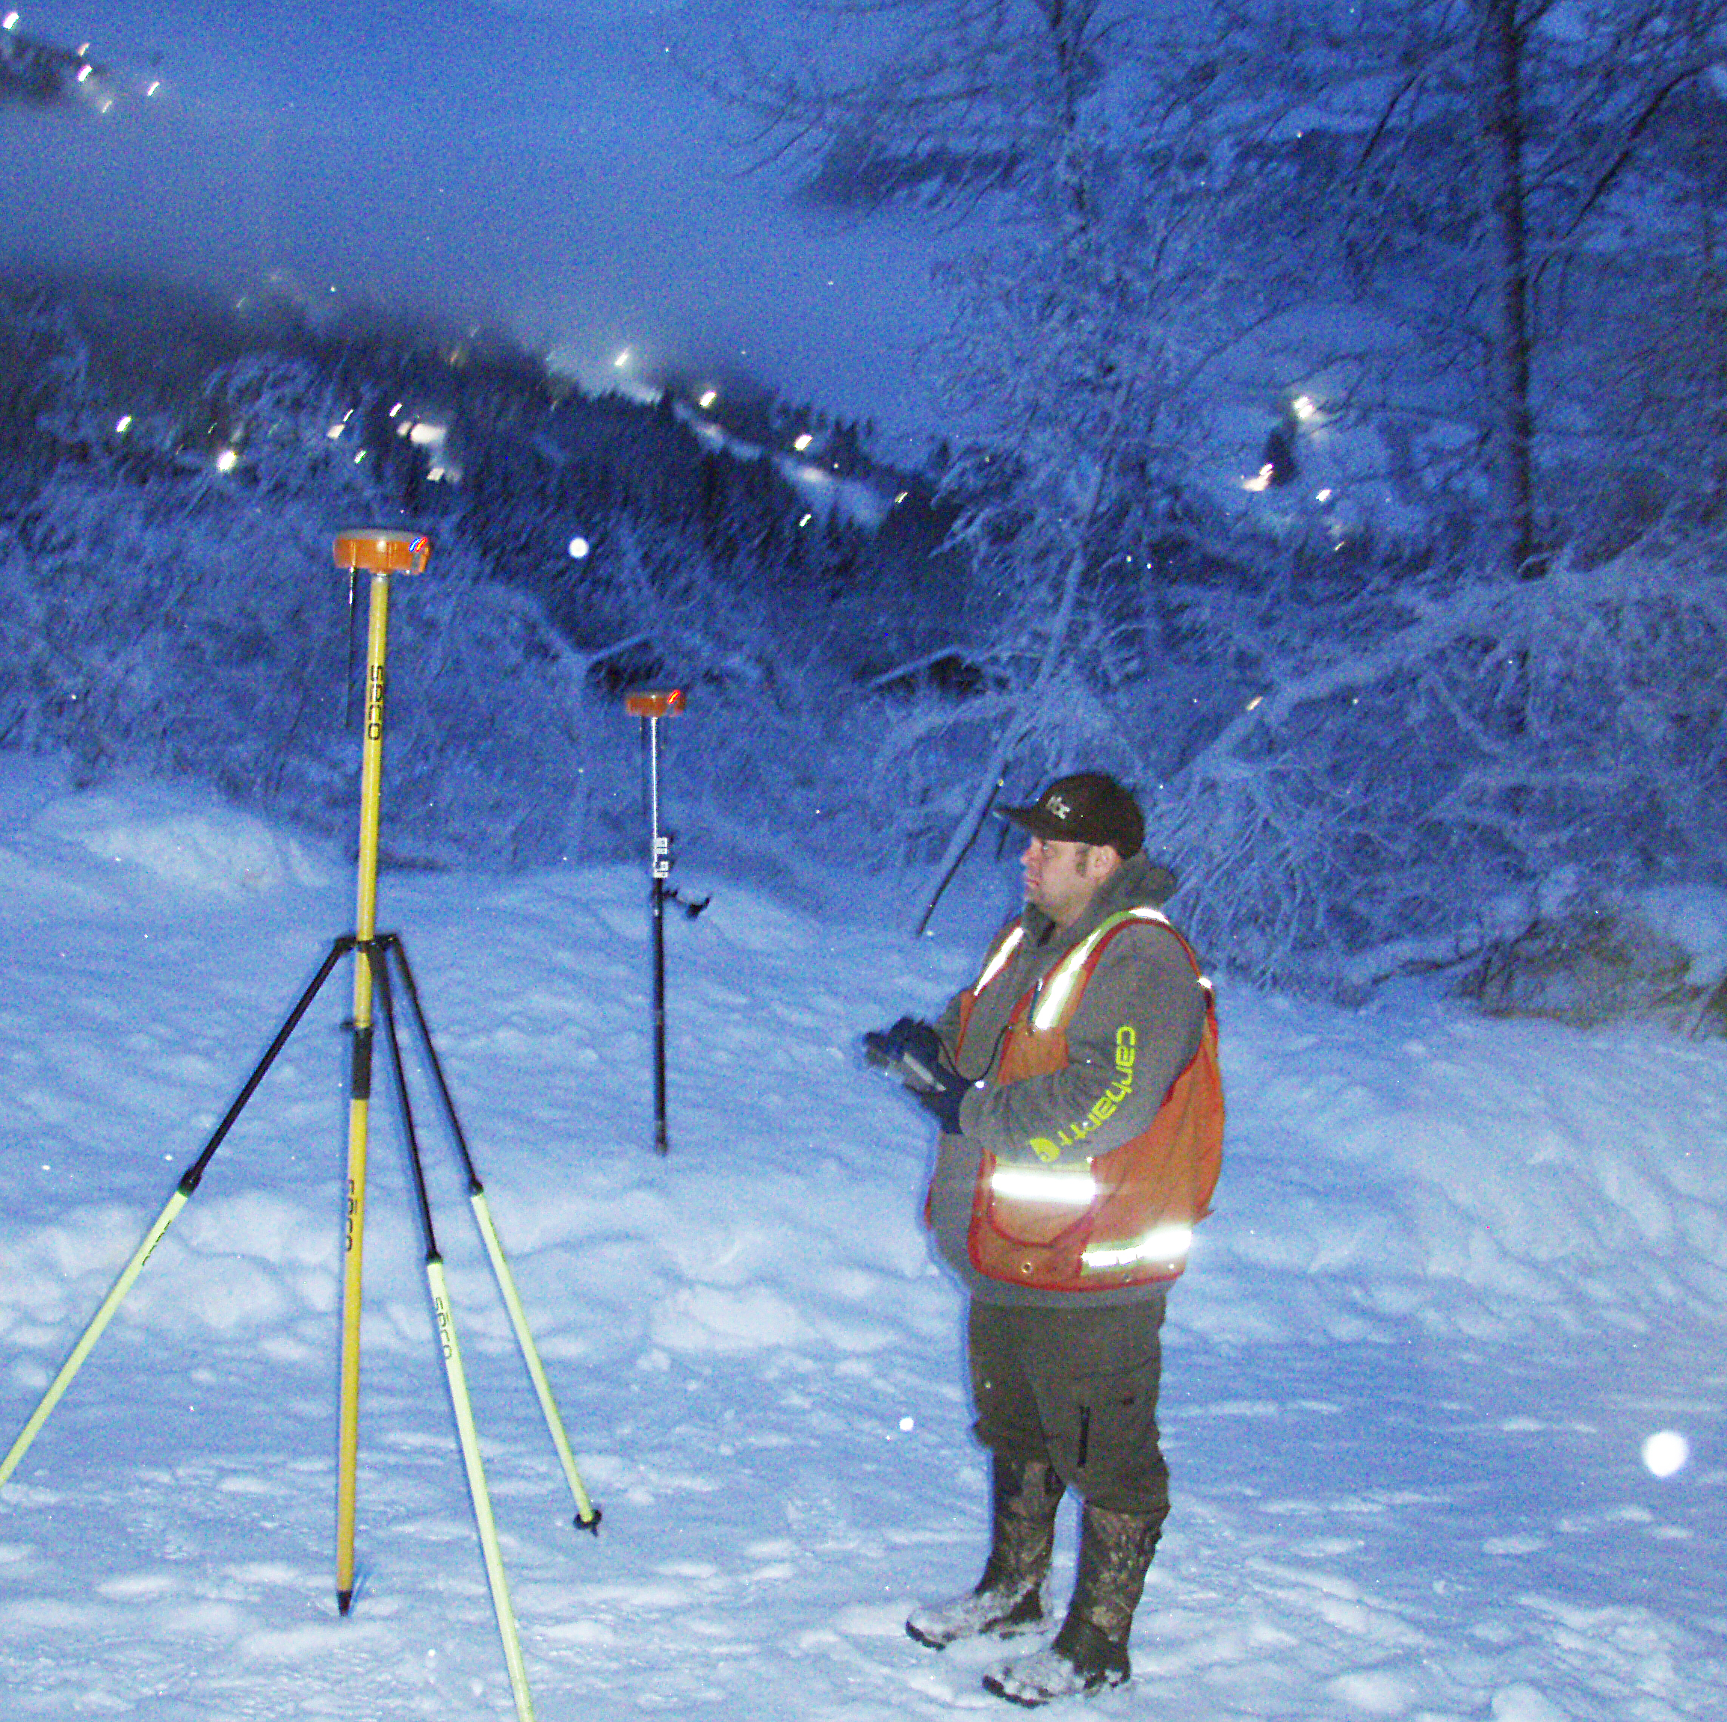
survey
The initial boundary and field work for the Tract plat and offsite utility and access design has been completed as of 12-18-21. The survey included boundary retracement of the 3 underlying
HLB tracts
Tract 1, Alyeska Subdivision, Prince Addition, Plat 87-131
Tract B of the Girdwood Elementary School Subdivision, Plat 85-38
Tract 9A of the Supplemental Cadastral Survey (Plat 73-220)

Slide 20
survey
The survey also included some retracement of the existing streams, trails and Glacier Creek high water as they affect the Holtan Hills development.
The next survey related steps include the following:
Preparation and submittal of the DNR application for section line vacation through the development
Preparation of the draft Holtan Hills Tract Plat, Conditional Application and Planned Unit Development documents for MOA submittal

Slide 21
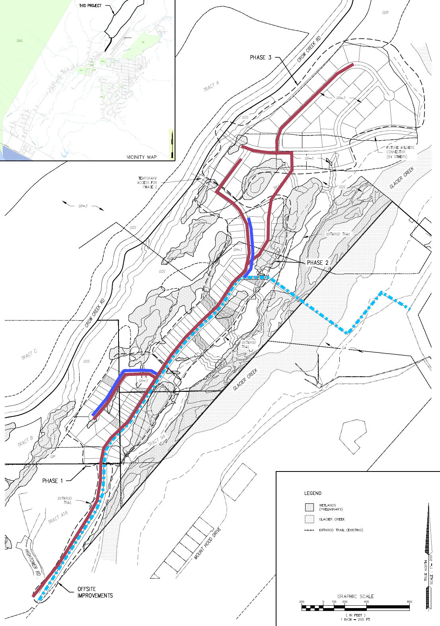
General utility plan

Slide 22
Development Tasks
Permitting
Rezone
Wetlands Delineations
Section Line Easement Vacations
Planning and Zoning Approval
Civil Design

Slide 23
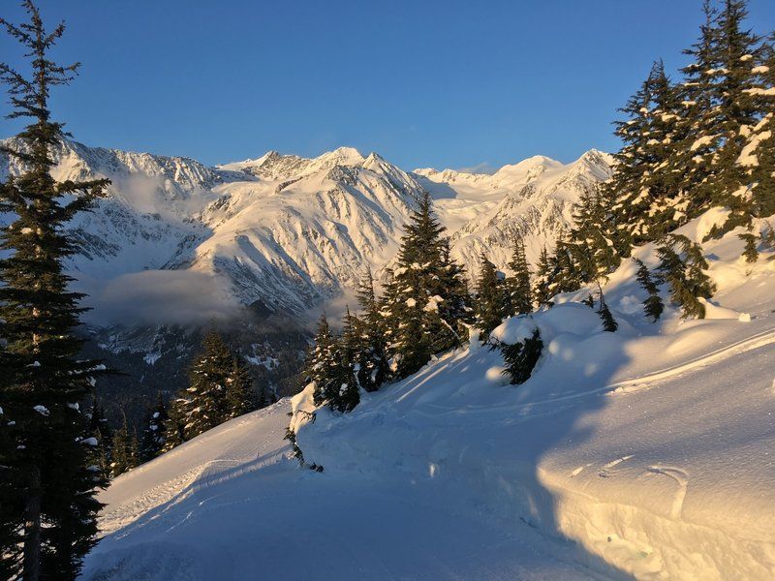
Federal, state, and local government actions
Federal Government confirmation of wetlands and any necessary permitting
State government approval of Section Line Easement Vacations
Local government must approve via Planning and Zoning Commission for the PUD/CUP

Slide 24
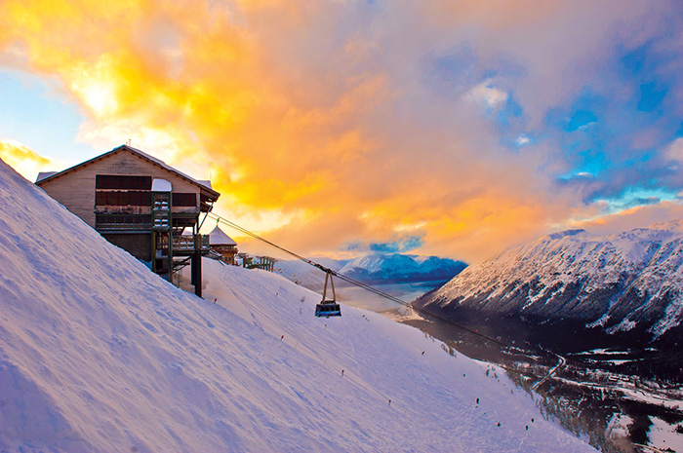
Economic challenges we have no control over
Supply chain disruptions
Labor shortages
Inflated prices

Slide 25
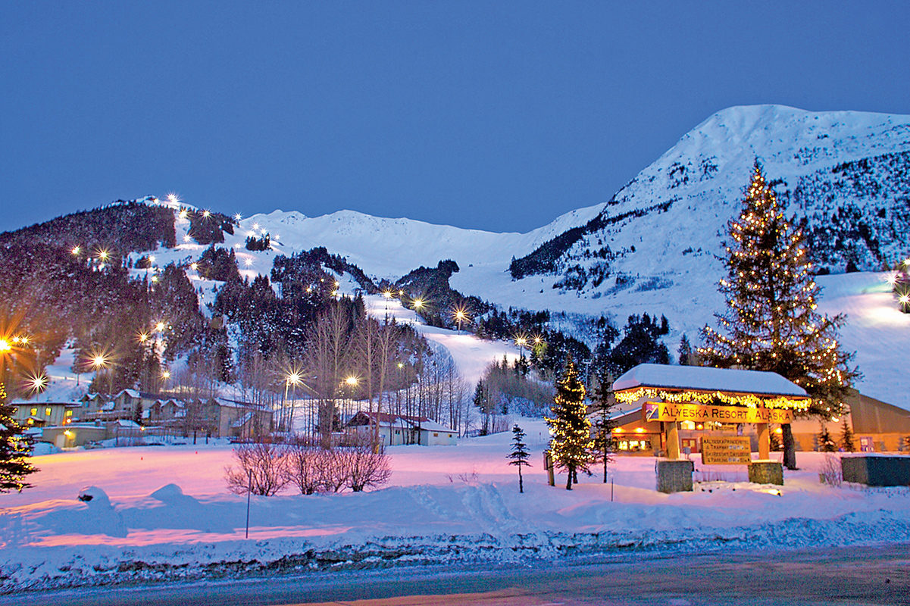
Holtan Hills Homeowner’s association
A homeowner’s association will be created for Holtan Hills. The HOA will include detailed design criteria including:
Exterior siding types
Exterior paint colors
Trail maintenance
Recreational Vehicle Parking
Minimum home size
Tree preservation

Slide 26
Frequently asked questions
Who will be building the homes in Holtan Hills?
The homesites will be available to any builder or private party. All buyers will be required to follow the Design Criteria for the Community.
Who will be building the road?
That decision has not been made yet. Once the civil plans are completed, the project will be sent out to bid to general contractors who have the capacity and bonding capability to perform.

Slide 27
Frequently asked questions
3. When is construction expected to begin?
The timeline for the beginning of construction is dependent upon receiving the approvals needed from Federal, State, and Local governments.
4. Where can I get a copy of the DRAFT Holtan Hills site plan?
The DRAFT site plan is available on the Heritage Land Bank website: https://www.muni.org/Departments/hlb/Pages/default.aspx

Slide 28
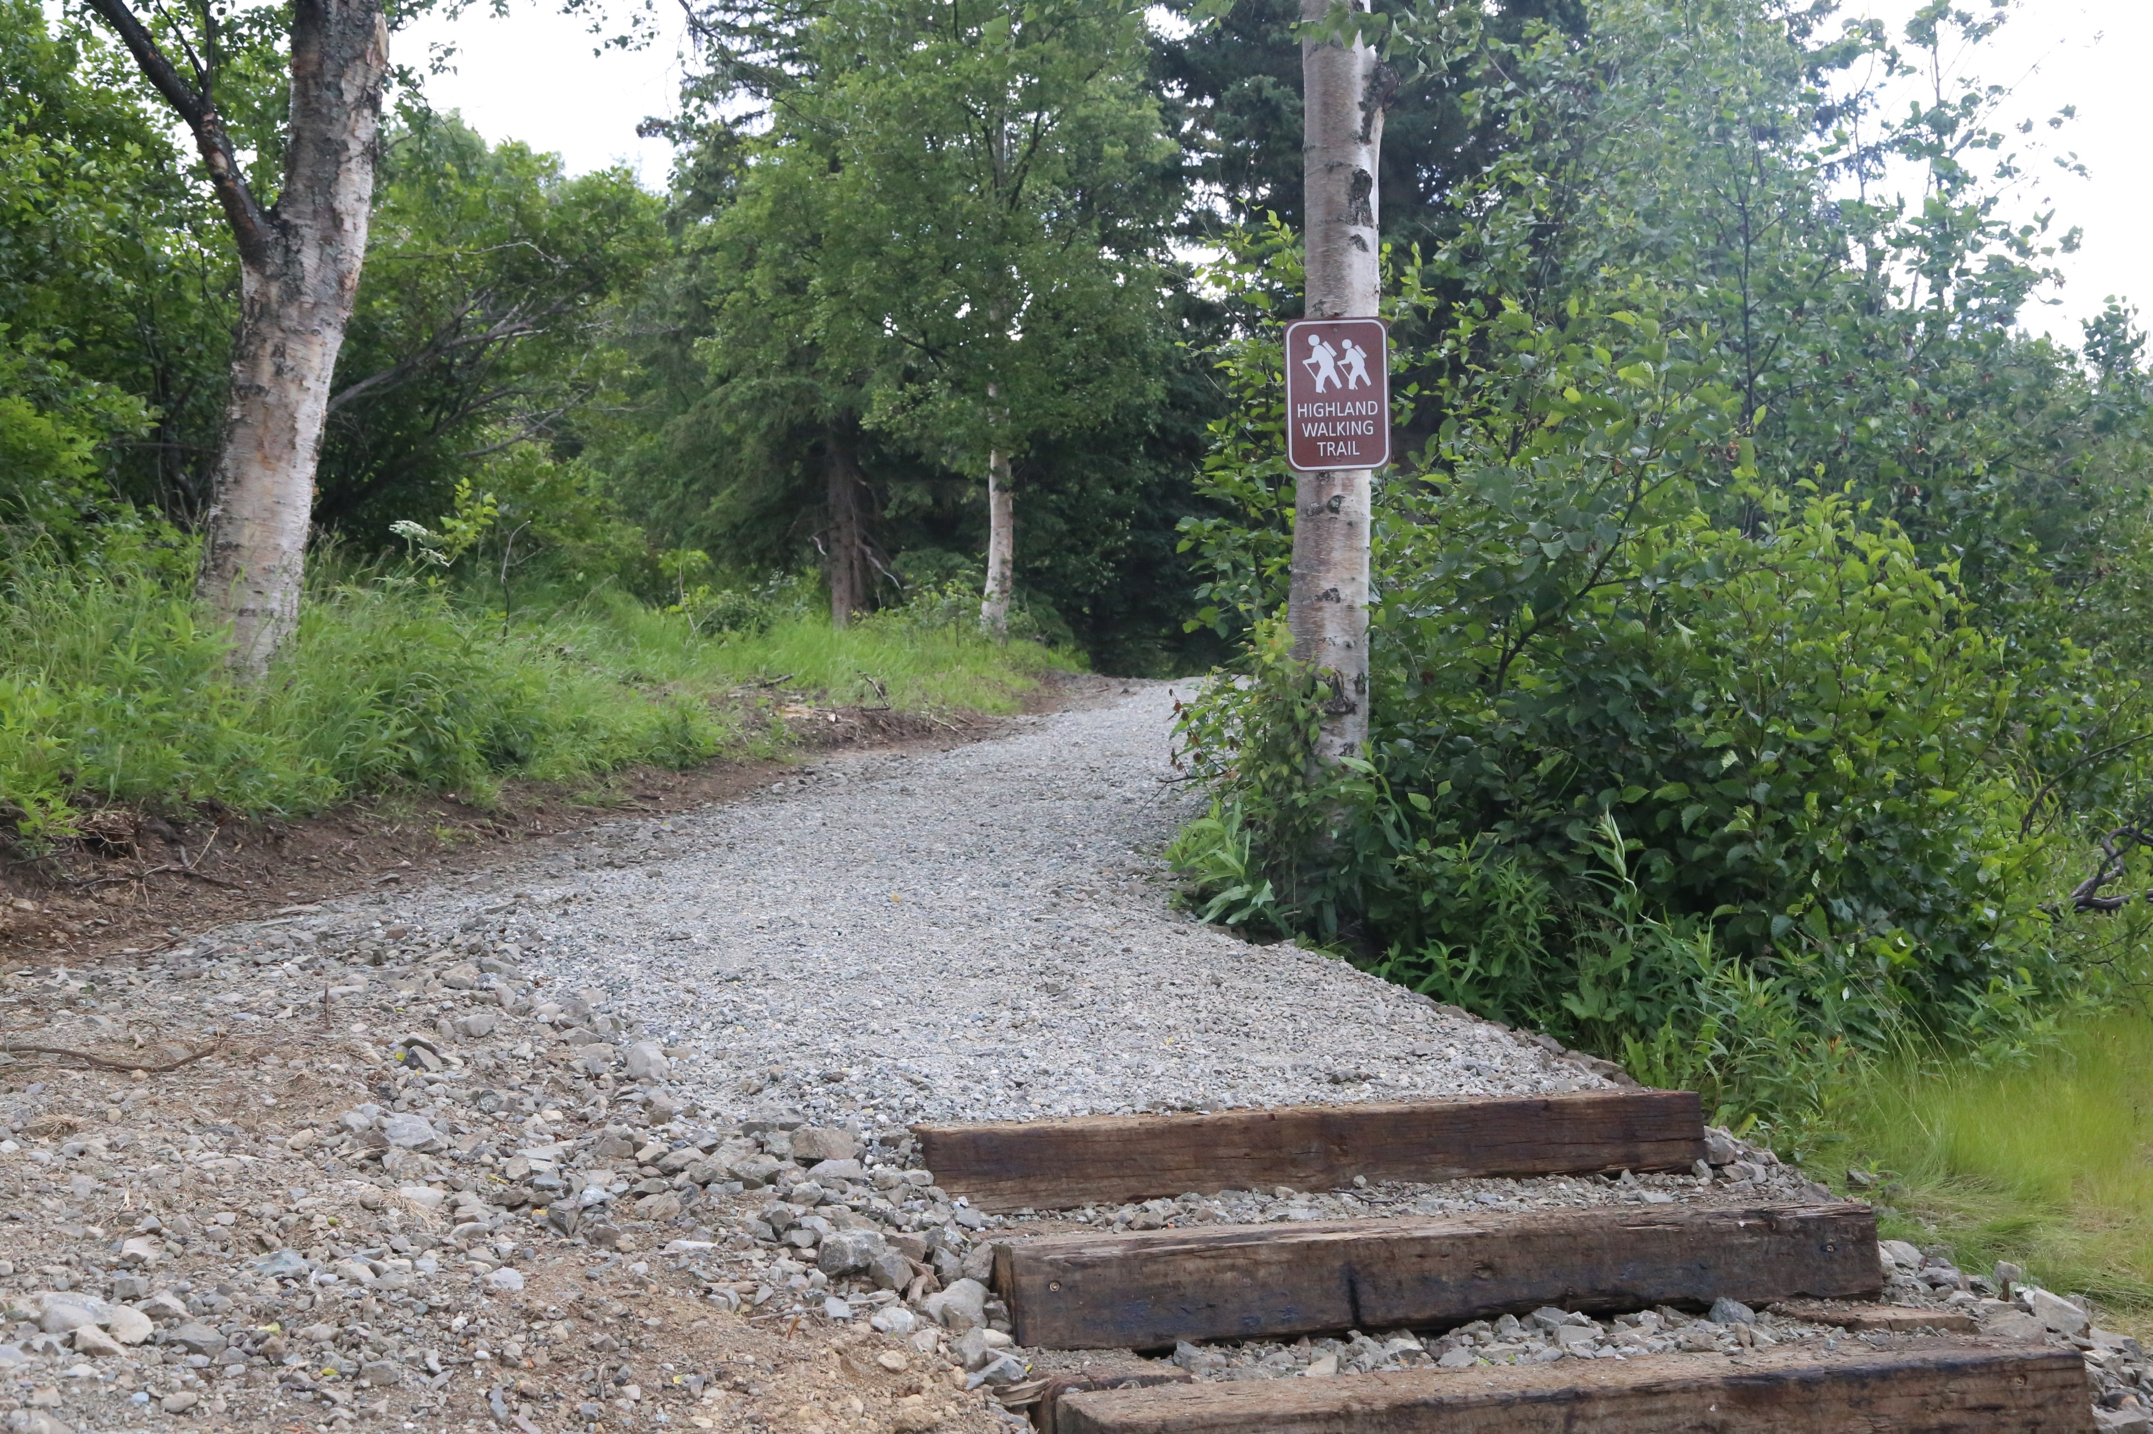
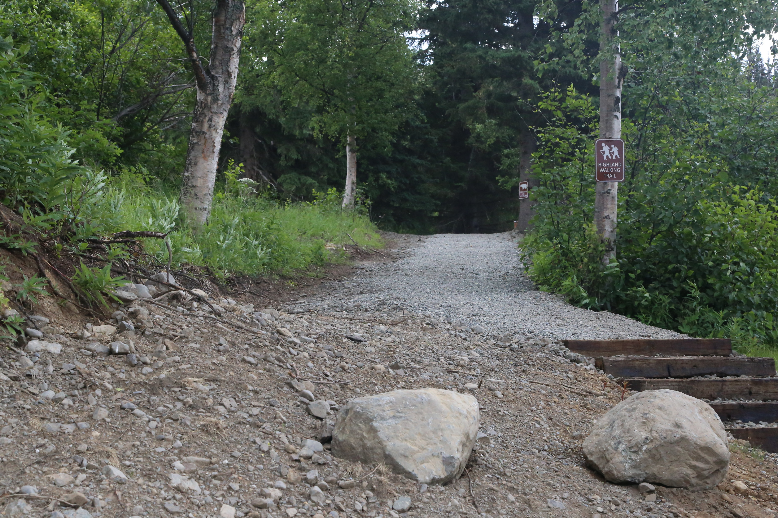
Frequently asked questions
5. Trails are very important to Girdwood Residents. What is your plan for adding trails to Holtan Hills?
As the site plan develops, trails will be intergraded into the Community including access to the Athabascan Trail and the Historic Iditarod Trail.
CY Investments, LLC recently built a 1.5-mile trail in Potter Highlands.

Slide 29
Frequently asked questions
6. What about the trees?
The development team recognizes the irreplaceable value of trees to a community.
The preservation of trees will be integrated into the Design Criteria for Holtan Hills.
For the general contractor, we ribbon trees adjacent to the ROW that are not to be cut, and we will fine $500 for any ribboned tree that has been cut down.
We include in the purchase and sale agreement that the home builder must minimize the area cleared for construction. The extent of this will be determined by the house design, slope, and grade of the homesite.
Trees, bush and dead materials must be removed from the site so we can be a Firewise community.

Slide 30
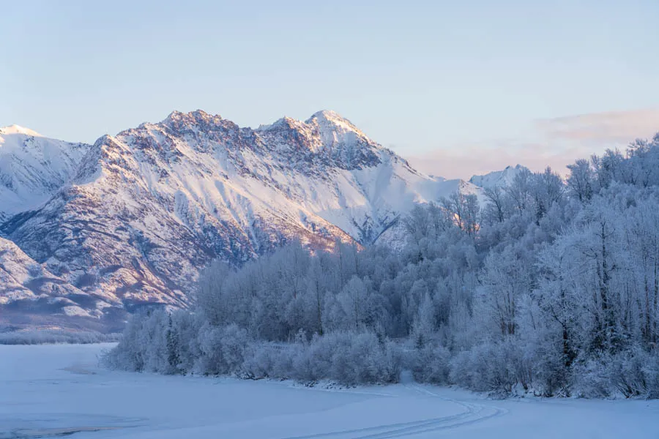
Holtan hills logo design contest
In order to embody the spirit of Girdwood, we would like the residents of Girdwood to design the logo for Holtan Hills.
The logo design contest will run through April 1, 2022.
Send your submissions to natalie@bhhsalaska.com
Winner will receive a $150 gift card for dinner at the restaurant of their choice.

Slide 31
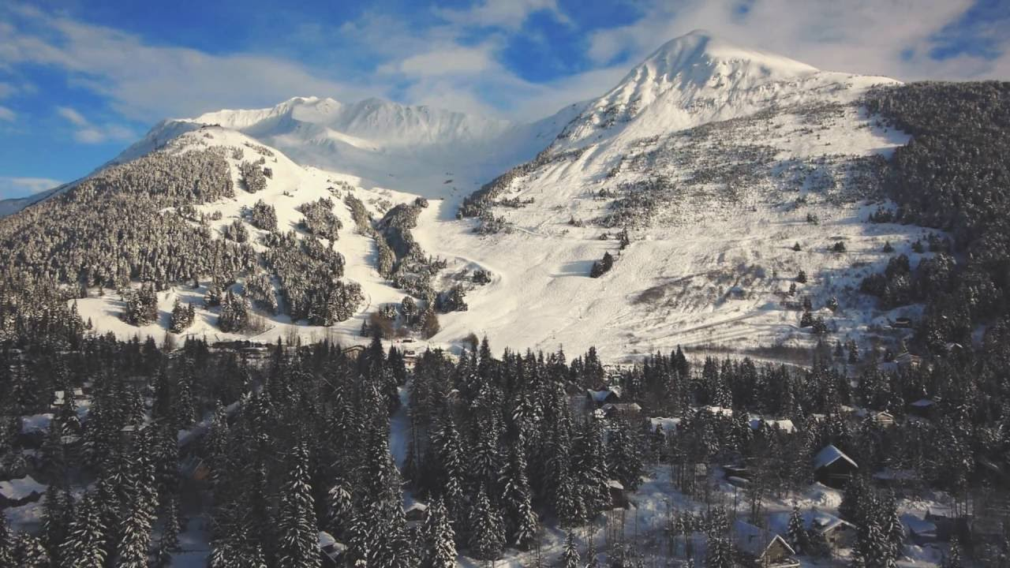
future Community update
February 2022
Specific date to be announced
The meeting will be noticed at least two weeks in advance

